Slide 1
Unit-5
Knowledge Inference

Slide 2
Knowledge Inference
The knowledge base stored facts about the world. The inference engine applied logical rules to the knowledge base and deduced new knowledge. This process would iterate as each new fact in the knowledge base could trigger additional rules in the inference engine. Inference engines work primarily in one of two modes either special rule or facts:
Forward chaining : Forward chaining starts with the known facts and asserts new facts.
Backward chaining : Backward chaining starts with goals, and works backward to determine what facts must be asserted so that the goals can be achieved.
Horn Clause and Definite clause: This clause are the forms of sentences, which enables knowledge base to use a more restricted and efficient inference algorithm.
Definite clause: A clause which is a disjunction of literals with exactly one positive literal is known as a definite clause or strict horn clause.
Horn clause: A clause which is a disjunction of literals with at most one positive literal is known as horn clause. Hence all the definite clauses are horn clauses.
Example: (¬ p V ¬ q V k). It has only one positive literal k. It is equivalent to p 𝖠 q → k.

Slide 3
Conti.
In propositional logic, resolution by forward/backward chaining
Forward: Start from knowledge to reach query
Backward: Start from query and go back
In FOL, substitute variables to get propositions
Use lifting and unification to resolve variables
Logic programming: Prolog, LISP, Haskell
Prolog: Most widely used logic language.
Rules are written in backwards. Variables are uppercase and constants lowercase. Because of complexity, often compiled into other languages like: Warren Abstract Machine, LISP or C. Language makes it easy to contruct lists, like LISP.
LISP: LISt Processing language: primary data structure is lists.
Lisp is used for AI because it can work with symbols. E.g: computer algebra, theorem proving, planning systems, diagnosis, rewrite systems, knowledge representation and reasoning, logic languages, machine translation, expert systems.
It is a functional programming language, as opposed to a procedural or imperative language

Slide 4







Rule-Based Systems
Control scheme
“interpreter”
condition | action
condition | action
condition | action
… | …
Rule n:
IF condition1 condition2
…
THEN
action1 action2
…
Database of facts “Working
memory”
When one part of the IF portion matches a fact in working memory, the antecedent is SATISFIED. When all antecedents are satisfied, the rule is TRIGGERED. When the consequent of a rule is performed, the rule is FIRED.

Slide 5
Three Phases
Match phase
Match left side of rules (antecedents) with facts in working memory
Unification
Conflict resolution
Of all the rules that are triggered, decide which rule to fire.
Some strategies include:
Do not duplicate rule with same instantiated arguments twice
Prefer rules that refer to recently created WM elements
Prefer rules that are more specific (antecedents are more constraining)
Prefer Mammal(x) & Human(x) -> add Legs(x,2) over Mammal(x) -> add Legs(x,4)
If rules are ranked, fire according to ranking
Act phase
Add or delete facts to WM as specified by rule consequent

Slide 6
Forward Chaining
When a new fact is added to the KB, for each rule such that ``matches'' (unifies with) the premise If the other premises are known then add the conclusion to the KB and continue chaining
Forward chaining is data-driven. It is also known as a forward deduction or forward reasoning method when using an inference engine.
Forward chaining is a form of reasoning which start with atomic sentences in the knowledge base and applies inference rules (Modus Ponens) in the forward direction to extract more data until a goal is reached.
The Forward-chaining algorithm starts from known facts, triggers all rules whose premises are satisfied, and add their conclusion to the known facts. This process repeats until the problem is solved.
E.g. A, A->B, B. A is the starting point. A->B represents a fact. This fact is used to achieve a decision B.
E.g. Tom is running (A), If a person is running, he will sweat (A->B), Therefore, Tom is sweating. (B)

Slide 7
Forward Chaining
Properties of Forward-Chaining:
It is a process of making a conclusion based on known facts or data, by starting from the initial state and reaches the goal state.
Forward chaining approach is also called as data-driven as we reach to the goal using available data.
Forward chaining approach is commonly used in the expert system, such as CLIPS, business, planning, monitoring, control and interpretation application, automated inference engines, theorem proofs and production rule systems.

Slide 8
Forward Chaining
"As per the law, it is a crime for an American to sell weapons to hostile nations. Country A, an enemy of America, has some missiles, and all the missiles were sold to it by Robert, who is an American citizen."
Prove that "Robert is criminal."
First convert all the above facts into first-order definite clauses,
Facts Conversion into FOL:
It is a crime for an American to sell weapons to hostile nations. (Let's say p, q, and r are variables)
American (p) 𝖠 weapon(q) 𝖠 sells (p, q, r) 𝖠 hostile(r) → Criminal(p) .....(1)
Country A has some missiles. there exist p Owns(A, p) 𝖠 Missile(p). It can be written in two definite clauses by using Existential Instantiation, introducing new Constant T1.
Owns(A, T1) …..(2)
Missile(T1) .….(3)
All of the missiles were sold to country A by Robert.
forall p Missiles(p) 𝖠 Owns (A, p) → Sells (Robert, p, A) .....(4)
Missiles are weapons.
Missile(p) → Weapons (p) .......(5)

Slide 9
Forward Chaining
Enemy of America is known as hostile.
Enemy(p, America) →Hostile(p) ........(6)
Country A is an enemy of America.
Enemy (A, America) ….….(7)
Robert is American
American(Robert). ……..(8)

Slide 10
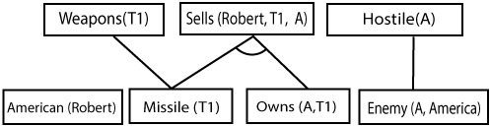
Forward Chaining
Step-1:
In the first step we will start with the known facts and will choose the sentences which do not have implications, such as: American(Robert), Enemy(A, America), Owns(A, T1), and Missile(T1).
Step-2:
At the second step, we will see those facts which infer from available facts and with satisfied premises.
Rule-(1) does not satisfy premises, so it will not be added in the first iteration.
Rule-(2) and (3) are already added.
Rule-(4) satisfy with the substitution {p/T1}, so Sells (Robert, T1, A) is added, which infers from the conjunction of Rule (2) and (3).
Rule-(6) is satisfied with the substitution(p/A), so Hostile(A) is added and which infers from Rule-(7).

Slide 11
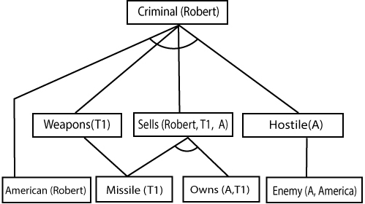
Forward Chaining
Step-3: At Step-3, as we can check Rule-(1) is satisfied with the substitution {p/Robert, q/T1, r/A}, so we can add Criminal(Robert) which infers all the available facts. And hence we reached our goal statement.
Hence it is proved that Robert is Criminal using forward chaining approach.

Slide 12
Forward Chaining
Advantages
It can be used to draw multiple conclusions.
It provides a good basis for arriving at conclusions.
It’s more flexible than backward chaining because it does not have a limitation on the data derived from it.
Disadvantages
The process of forward chaining may be time-consuming. It may take a lot of time to eliminate and synchronize available data.
Unlike backward chaining, the explanation of facts or observations for this type of chaining is not very clear. The former uses a goal-driven method that arrives at conclusions efficiently.

Slide 13
Forward Chaining
There are two main types of control schemes that are applied to rule-based systems.
Z1 If ?x has hair
Then ?x is a mammal Z2 If ?x gives milk
Then ?x is a mammal
Z3 If ?x has feathers Then ?x is a bird
Z6 If ?x is a mammal
?x has pointed teeth
?x has claws
?x has forward-pointing eyes Then ?x is a carnivore
Z8 If ?x is a mammal
?x chews cud
Then ?x is an ungulate Z11 If ?x is an ungulate
?x has long legs
?x has long neck
?x has tawny color
?x has dark spots Then ?x is a giraffe
Database
------------
F1) Stretch has hair
F2) Stretch chews cud
F3) Stretch has long legs
F4) Stretch has a long neck F5) Stretch has tawny color F6) Stretch has dark spots

Slide 14
Forward Chaining
Reason FORWARD from facts/rules to (hopefully) a needed goal
Use modus ponens to generate new facts
Rule antecedents are compared with facts from database
If match, add consequents to database
Repeat as long as needed
Forward chaining is “data driven”

Slide 15
Backward Chaining
Backward-chaining is also known as a backward deduction or backward reasoning method when using an inference engine.
A backward chaining algorithm is a form of reasoning, which starts with the goal and works backward, chaining through rules to find known facts that support the goal.
Backward chaining can be used in debugging, diagnostics, prescription applications, game theory, automated theorem proving tools, inference engines, proof assistants, and various AI applications.
When a query q is asked
if a matching fact q’ is known, return the unifier
for each rule whose consequent q’ matches q
attempt to prove each premise of the rule by backward chaining
Two versions: find any solution, find all solutions
Backward chaining is the basis for logic programming, e.g., Prolog

Slide 16
Backward Chaining
Properties of backward chaining:
In backward chaining, the goal is broken into sub-goal or sub-goals to prove the facts true. It is called a goal-driven approach, as a list of goals decides which rules are selected and used.
The modus ponens inference rule is used as the basis for the backward chaining process. This rule states that if both the conditional statement (p->q) and the antecedent (p) are true, then we can infer the subsequent (q).
Use modus ponens
Start at goals
Match goals to consequents or facts
If match consequents, antecedents become new sub goals
Repeat until
All sub goals are proven or
At least one sub goal cannot be proven

Slide 17
Backward Chaining
Backward chaining can be explained in the following sequence.
B, A->B, A.
B is the goal or endpoint, that is used as the starting point for backward tracking. A is the initial state. A->B is a fact that must be asserted to arrive at the endpoint B.
E.g. Tom is sweating (B), If a person is running, he will sweat (A->B), Tom is running (A).
Advantages
The result is already known, which makes it easy to deduce inferences.
It’s a quicker method of reasoning than forward chaining because the endpoint is available.
In this type of chaining, correct solutions can be derived effectively if pre-determined rules are met by the inference engine.
Disadvantages
The process of reasoning can only start if the endpoint is known.
It doesn’t deduce multiple solutions or answers.
It only derives data that is needed, which makes it less flexible than forward chaining.

Slide 18
Backward Chaining
The backward-chaining method mostly used a depth-first search strategy for proof.
Example:
In backward-chaining, we will use the same above example, and will rewrite all the rules.
American (p) 𝖠 weapon(q) 𝖠 sells (p, q, r) 𝖠 hostile(r) → Criminal(p) ...(1)
 | Owns(A, T1) ........(2)
• • | Missile(T1) Forall p Missiles(p) 𝖠 Owns (A, p) → Sells (Robert, p, A) | ......(4)
• | Missile(p) → Weapons (p) .......(5)
• | Enemy(p, America) →Hostile(p) ........(6)
• | Enemy (A, America) .........(7)
• | American(Robert). ..........(8)

Slide 19
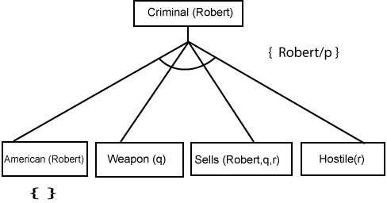
Backward Chaining
Backward-Chaining proof:- In Backward chaining, we will start with our goal predicate, which is Criminal(Robert), and then infer further rules.
Step-1: At the first step, we will take the goal fact. And from the goal fact, we will infer other facts, and at last, we will prove those facts true. So our goal fact is "Robert is Criminal," so following is the predicate of it.
Step-2: At the second step, we will infer other facts from goal fact which satisfies the rules. So as we can see in Rule-1, the goal predicate Criminal(Robert) is present with substitution {Robert/P}. So we will add all the conjunctive facts below the first level and will replace p with Robert.

Slide 20
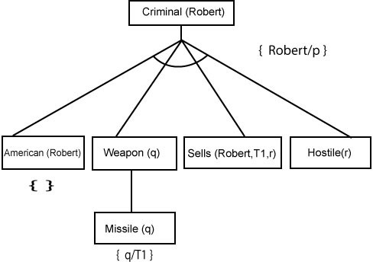
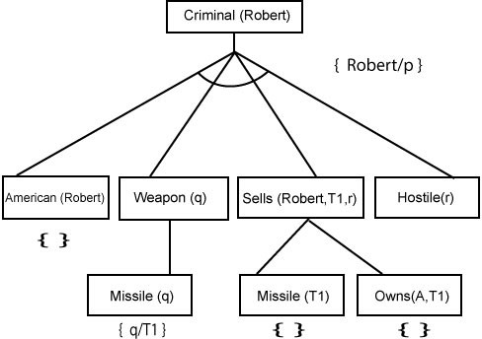
Backward Chaining
Step-3: At step-3, we will extract further fact Missile(q) which infer from Weapon(q), as it satisfies Rule-(5). Weapon (q) is also true with the substitution of a constant T1 at q.
Step-4: At step-4, we can infer facts Missile(T1) and Owns(A, T1) from Sells(Robert, T1, r) which satisfies the Rule- 4, with the substitution of A in place of r. So these two statements are proved here.

Slide 21
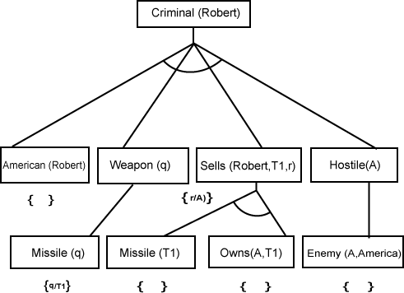
Backward Chaining
Step-5: At step-5, we can infer the fact Enemy(A, America) from Hostile(A) which satisfies Rule-6. And hence all the statements are proved true using backward chaining.

Slide 22
Forward Chaining vs. Backward Chaining
Forward Chaining | Backward Chaining
It starts from known facts and applies inference rule to extract more data unit it reaches to the goal. | It starts from the goal and works backward through inference rules to find the required facts that support the goal.
It is a top down approach. | It is a bottom-up approach.
It is known as data-driven inference technique as we reach to the goal using the available data. | It is known as goal-driven technique as we start from the goal and divide into sub-goal to extract the facts.
It applies a breadth-first search strategy. | It applies a depth-first search strategy
It tests for all the available rules | It tests only for few required rules.
It is suitable for the planning, monitoring, control, and interpretation application. | It is suitable for diagnostic, prescription, and debugging application.
It can generate an infinite number of possible conclusions. | It generates a finite number of possible conclusions.

Slide 23
Reasoning System
The reasoning is the mental process of deriving logical conclusion and making predictions from available knowledge, facts, and beliefs or we can say, "Reasoning is a way to infer facts from existing data." It is a general process of thinking rationally, to find valid conclusions.
Human reasoning capability are divided into three areas:
Mathematical reasoning-axioms, definitions, theorems, proofs
Logical reasoning – deductive, inductive, abductive
Non-logical reasoning – linguistic, language
These 3 areas of reasoning are in every human being but the ability level depends on education, environment and genetics.
Approaches to reasoning- Symbolic, statistical and fuzzy logic reasoning
To help machines perform human-level functions, AI and its various subfields rely on reasoning and knowledge representation. Reasoning in AI helps machines think rationally and perform functions like humans. Helps machines in problem-solving, deriving logical solutions, and making predictions based on the available information, knowledge, facts, and data.
Additionally, reasoning can be performed either in a formal and informal manner or top-down or bottom-up approaches, depending on the way machines handle uncertainties and partial truths. Like Probabilistic Reasoning in AI allows machines to deal with and represent uncertain knowledge and information.

Slide 24
Role of Reasoning in Knowledge-based Systems
Among the various types of reasoning, deductive reasoning and non-monotonic reasoning are used by knowledge-based systems to solve problems. Moreover, it helps with the implementation of knowledge-based systems and AI in machines, enabling them to perform tasks that require human level intelligence and mental processes.
In short, like humans, machines use reasoning, along with knowledge representation, logic, and learning for analysis, problem-solving, making conclusions, and more.
Properties of Information:
Complete: All the facts that are necessary to solve a problem are present in the system. E.g., Question Answering or proof.
Consistent: There is no contradiction in the available information. E.g., we should not be able to derive both P and ~P.
Monotonous / Monotonically Growing: An addition of information does not make existing information false, or inconsistent.
When the information is not complete, or inconsistent, we need Non-Monotonic Reasoning Systems.

Slide 25
Uncertainty
The world is an uncertain place, often the knowledge is imperfect which causes uncertainty. Therefore reasoning must be able to operate under uncertainty.
Uncertain inputs
Missing data
Noisy data
Uncertain knowledge
Multiple causes lead to multiple effects
Incomplete enumeration of conditions or effects
Incomplete knowledge of causality in the domain
Probabilistic effects
Uncertain outputs
Abduction and induction are inherently uncertain
Default reasoning, even in deductive fashion, is uncertain
Incomplete deductive inference may be uncertain

Slide 26
Reasoning under uncertainty
The reasoning is the mental process of deriving logical conclusion and making predictions from available knowledge, facts, and beliefs. Or we can say, "Reasoning is a way to infer facts from existing data." It is a general process of thinking rationally, to find valid conclusions.
Types of Reasoning
Monotonic Reasoning
Non Monotonic Reasoning
Common Sense Reasoning
Deductive reasoning
Inductive reasoning
Abductive reasoning

Slide 27
Monotonic Reasoning
In monotonic reasoning, once the conclusion is taken, then it will remain the same even if we add some other information to existing information in our knowledge base. In monotonic reasoning, adding knowledge does not decrease the set of prepositions that can be derived.
To solve monotonic problems, we can derive the valid conclusion from the available facts only, and it will not be affected by new facts.
Monotonic reasoning is not useful for the real-time systems, as in real time, facts get changed, so we cannot use monotonic reasoning.
Monotonic reasoning is used in conventional reasoning systems, and a logic-based system is monotonic.
Any theorem proving is an example of monotonic reasoning.
Example:
Earth revolves around the Sun.
It is a true fact, and it cannot be changed even if we add another sentence in knowledge base like, "The moon revolves around the earth" Or "Earth is not round," etc.

Slide 28
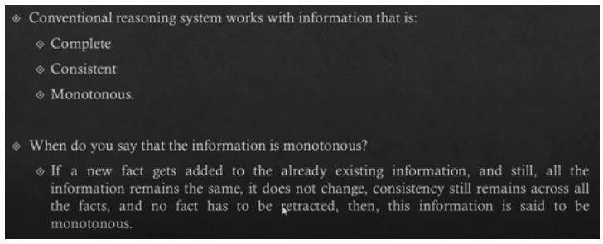
Monotonous Information

Slide 29
Monotonic Reasoning
Standard type of logic
If proven true, will be true forever
Facts provided can’t be modified
Doesn’t always fit in real life.
Sidra is in Doha and Doha is in Qatar, so Sidra is in Qatar.
Sidra can always take a trip to United States

Slide 30
Non Monotonic Reasoning
In Non-monotonic reasoning, some conclusions may be invalidated if we add some more information to our knowledge base. Non-monotonic reasoning deals with incomplete and uncertain models. "Human perceptions for various things in daily life, "is a general example of non-monotonic reasoning.
Example: Let suppose the knowledge base contains the following knowledge:
Birds can fly
Penguins cannot fly
Pitty is a bird
So from the above sentences, we can conclude that Pitty can fly. However, if we add one another sentence into knowledge base "Pitty is a penguin", which concludes "Pitty cannot fly", so it invalidates the above conclusion.

Slide 31
Non Monotonic Reasoning
A logic is non-monotonic if some conclusions can be invalidated by adding more knowledge. The logic of definite clauses with negation as failure is non-monotonic. Non-monotonic reasoning is useful for representing defaults. A default is a rule that can be used unless it overridden by an exception.
New facts can be added
Current facts can be modified
Conclusion can change
If A → B before new fact
Conclusion might change after new fact
Example
All balls bounce
Football is a ball
Does football bounce (Of course?)
What about a football with no air filled in? (Conclusions change with new facts)

Slide 32
Non Monotonic Reasoning
Real life usage : Used in artificial intelligent systems
For its adaptability
Adding, removing and modifying facts
To reach appropriate conclusions for appropriate scenarios
Application : Consider an example that can’t be handled by monotonic logic
Birds can fly (Seems logical, right?)

Slide 33
Non-monotonic Reasoning
Non-monotonic reasoning can be describe using default reasoning.
Default reasoning – The conclusions are drawn based on what is most likely to be true.
There are 2 approaches:
Non monotonic logic
Default logic
Non monotonic logic: The truth of a proposition may change when new information are added and a logic may be build to allows the statement to be retraced.
Non monotonic logic is predicate logic with one extension called model operator(M) which means “consistent with everything we know”.
The purpose of M is to allow consistency.

Slide 34
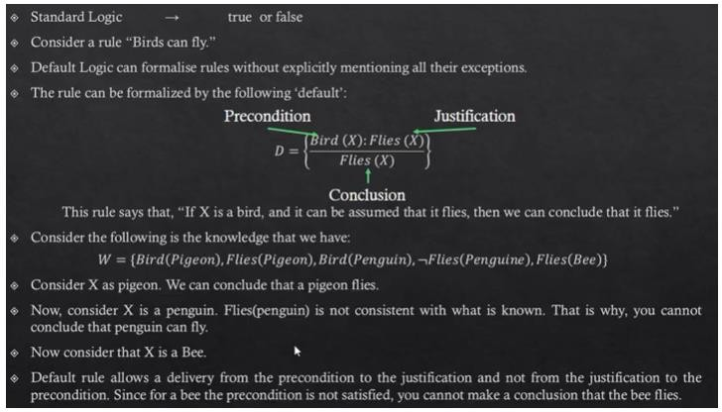
Default logic
Logic base system is not able to handle non monotonous information

Slide 35
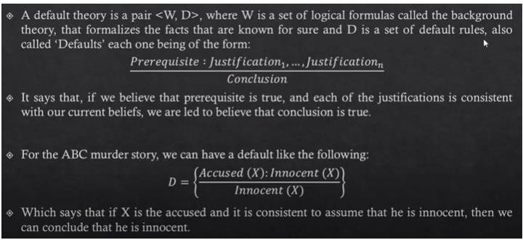
Default logic

Slide 36
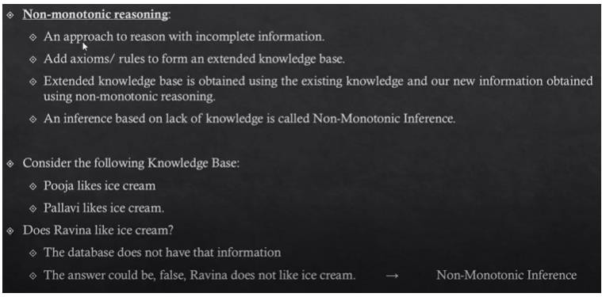
Non Monotonic Inference

Slide 37
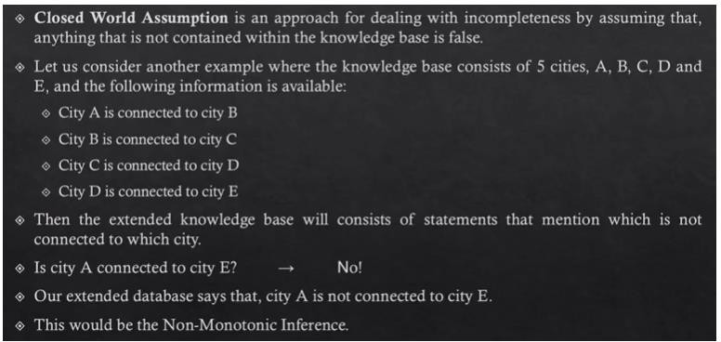
Closed World Assumption

Slide 38
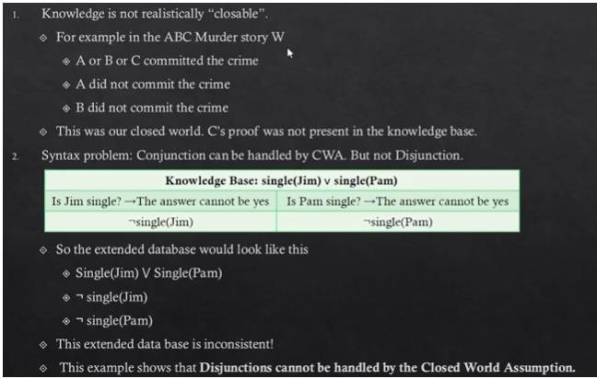
Limitations of Closed World Assumption

Slide 39
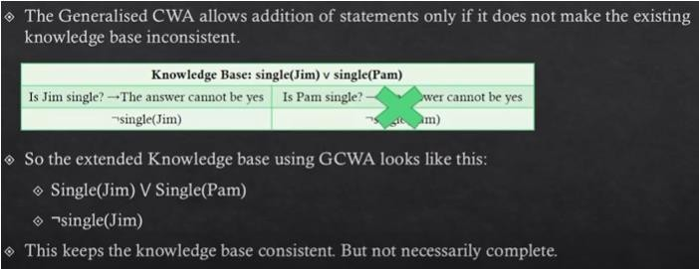
Generalized Closed World Assumption

Slide 40
Common sense Reasoning
Common sense reasoning is an informal form of reasoning, which can be gained through experiences.
Common Sense reasoning simulates the human ability to make presumptions about events which occurs on every day.
It relies on good judgment rather than exact logic and operates on heuristic knowledge and heuristic rules.
Example:
One person can be at one place at a time.
If I put my hand in a fire, then it will burn.
The above two statements are the examples of common sense reasoning which a human mind can easily understand and assume.
It is mainly used in computer vision and robotic manipulation.

Slide 41
Deductive Reasoning
Deductive reasoning is deducing new information from logically related known information. It is the form of valid reasoning, which means the argument's conclusion must be true when the premises are true.
Deductive reasoning is a type of propositional logic in AI, and it requires various rules and facts. It is sometimes referred to as top-down reasoning, and contradictory to inductive reasoning.
In deductive reasoning, the truth of the premises guarantees the truth of the conclusion.
Deductive reasoning mostly starts from the general premises to the specific conclusion, which can be explained as below example.
Example:
Premise-1: All the human eats veggies
Premise-2: Suresh is human.
Conclusion: Suresh eats veggies.

Slide 42
Deductive Reasoning
Deductive reasoning uses formal logic to produce logically certain results, using a set process, which involves the following steps.
Theory
Hypothesis
Patterns
Confirmation

Slide 43
Inductive Reasoning
An opposite of deductive reasoning, inductive reasoning is a bottom-up logic that uses specific observations to reach a conclusion.
Used in cases where there is a limited set of facts and data to arrive at a conclusion, Inductive reasoning uses historical data to produce a generic rule whose conclusion is supported by the premises.
Also known as cause-effect reasoning, this second type of reasoning is exploratory in nature and allows for uncertain but likely results.
Inductive reasoning follows a set of steps to perform reasoning, these are:
Observation
Pattern
Hypothesis
Theory

Slide 44
Inductive vs deductive reasoning
Deductive and inductive reasoning are opposites — deduction applies a top-to-bottom(general to specific) approach to reasoning whereas induction applies a bottom-to-top(specific to general) approach.
Inductive Reasoning – Specific to general
Logically true
May or may not be realistically true (But not definitely true)
Inductive reasoning frequently used in mathematics by observing patterns that exist in a particular case; we deduce the general conclusion from that outcome. It is looking for a pattern or looking for a trend and then generalizing.
The conclusion that we arrive based on inductive reasoning is called as conjecture. Conjecture is a hypothesis that has not be proven. Just because we observe a pattern in many cases does not mean it’s true for all cases. Conjecture must be prove for that particular case. To prove such conjecture, principal of mathematical induction is used.
Inductive reasoning starts with a specific assumption, then it broadens in scope until it reaches a generalized conclusion. With inductive reasoning, the conclusion may be false even if the premises are true.

Slide 45
Inductive vs deductive reasoning
Deductive Reasoning – General argument to specific conclusion
Logically true
Realistically true (Always true)

Slide 46
Inductive vs deductive reasoning
Inductive Reasoning: The first lipstick I pulled from my bag is red. The second lipstick I pulled from my bag is red. Therefore, all the lipsticks in my bag are red.
Deductive Reasoning: The first lipstick I pulled from my bag is red. All lipsticks in my bag are red. Therefore, the second lipstick I pull from my bag will be red, too.
Inductive Reasoning: My mother is Irish. She has blond hair. Therefore, everyone from Ireland has blond hair.
Deductive Reasoning: My mother is Irish. Everyone from Ireland has blond hair. Therefore, my mother has blond hair.
Inductive Reasoning: Maximilian is a shelter dog. He is happy. All shelter dogs are happy.
Deductive Reasoning: Maximillian is a shelter dog. All shelter dogs are happy. Therefore, he is happy.

Slide 47
Inductive vs. Deductive Reasoning
Inductive and deductive reasoning are the two most important and commonly used reasoning techniques.
INDUCTIVE REASONING | DEDUCTIVE REASONING
This type of reasoning reaches the conclusion through the process of generalization using facts and data. | Type of valid reasoning, where new information or conclusion is deduced using known facts and information.
It follows a bottom-up approach and starts from the conclusion. | It follows a top-down approach and starts from the premises.
The conclusion is not guaranteed to be true if the premises are true. | Here the conclusion is true if the premises are true.
It is fast and easy, as it requires evidence instead of facts. | Compared to inductive reasoning, it is difficult to use as it requires true facts.

Slide 48
Inductive research approach
When there is little to no existing literature on a topic, it is common to perform inductive research because there is no theory to test. The inductive approach consists of three stages:
Observation
A low-cost airline flight is delayed
Dogs A and B have fleas
Elephants depend on water to exist
Observe a pattern
Another 20 flights from low-cost airlines are delayed
All observed dogs have fleas
All observed animals depend on water to exist
Develop a theory
Low cost airlines always have delays
All dogs have fleas
All biological life depends on water to exist
Limitations of an inductive approach
A conclusion drawn on the basis of an inductive method can never be proven, but it can be invalidated.

Slide 49
Deductive research approach
When conducting deductive research, you always start with a theory (the result of inductive research). Reasoning deductively means testing these theories. If there is no theory yet, you cannot conduct deductive research. The deductive research approach consists of four stages:
Start with an existing theory
Low cost airlines always have delays
All dogs have fleas
All biological life depends on water to exist
Formulate a hypothesis based on existing theory
If passengers fly with a low cost airline, then they will always experience delays
All pet dogs in my apartment building have fleas
All land mammals depend on water to exist

Slide 50
Deductive research approach
Collect data to test the hypothesis
Collect flight data of low-cost airlines
Test all dogs in the building for fleas
Study all land mammal species to see if they depend on water
Analyse the results: does the data reject or support the hypothesis?
5 out of 100 flights of low-cost airlines are not delayed = reject hypothesis
10 out of 20 dogs didn’t have fleas = reject hypothesis
All land mammal species depend on water = support hypothesis

Slide 51
Deductive research approach
Limitations of a deductive approach
The conclusions of deductive reasoning can only be true if all the premises set in the inductive study are true and the terms are clear.
Example
All dogs have fleas (premise)
Benno is a dog (premise)
Benno has fleas (conclusion)
Based on the premises we have, the conclusion must be true. However, if the first premise turns out to be false, the conclusion that Benno has fleas cannot be relied upon.

Slide 52
Abductive Reasoning
An extension of deductive reasoning, abductive reasoning, is a form of logical inference that seeks theories to define observations using the simplest and likely explanation.
Compared to inductive reasoning, abductive reasoning, which is also known as abductive inference or retroduction, is less rigorous and allows for most accurate suggestions and guesses.
However, unlike deductive reasoning, it does not rectify the plausible conclusion and is mostly used in data certainties. It is associated with troubleshooting and decision making.
Abductive reasoning is a form of logical reasoning which starts with single or multiple observations then seeks to find the most likely explanation or conclusion for the observation. Abductive reasoning is an extension of deductive reasoning, but in abductive reasoning, the premises do not guarantee the conclusion.
Example:
Incomplete observations -> Best Prediction (may be true)
Implication: Cricket ground is wet if it is raining
Axiom: Cricket ground is wet.
Conclusion It is raining.

Slide 53
Probabilistic Reasoning
Probabilistic reasoning is a way of knowledge representation where we apply the concept of probability to indicate the uncertainty in knowledge. In probabilistic reasoning, we combine probability theory with logic to handle the uncertainty.
We use probability in probabilistic reasoning because it provides a way to handle the uncertainty that is the result of someone's laziness and ignorance.
In the real world, there are lots of scenarios, where the certainty of something is not confirmed, such as "It will rain today," "behaviour of someone for some situations," "A match between two teams or two players." These are probable sentences for which we can assume that it will happen but not sure about it, so here we use probabilistic reasoning.
Need of probabilistic reasoning in AI:
When there are unpredictable outcomes.
When specifications or possibilities of predicates becomes too large to handle.
When an unknown error occurs during an experiment.
In probabilistic reasoning, there are two ways to solve problems with uncertain knowledge:
Bayes' rule
Bayesian Statistics

Slide 54
Bayes' Theorem
P(H | E)
Hypothesis Evidence
Truthiness is depend on how many evidence supporting the hypothesis.
P( Hi | E) – What is probability of hypothesis that evidence is available.
P(E | Hi) – Probability of evidence being present for a particular hypothesis.
P(Hi) – Probability for ith hypothesis to true (Whatever evidence available or not)
Bayes’ theorem:
P(Hi | E) = P(E | Hi) * P(Hi) / ∑ P(E | Hn) * P(Hn) , where n=1 to k.
Application of Baye’s theorem in AI
Next step is calculated based on prior step
Robot
Automatic Machine
Forecasting
Weather

Slide 55
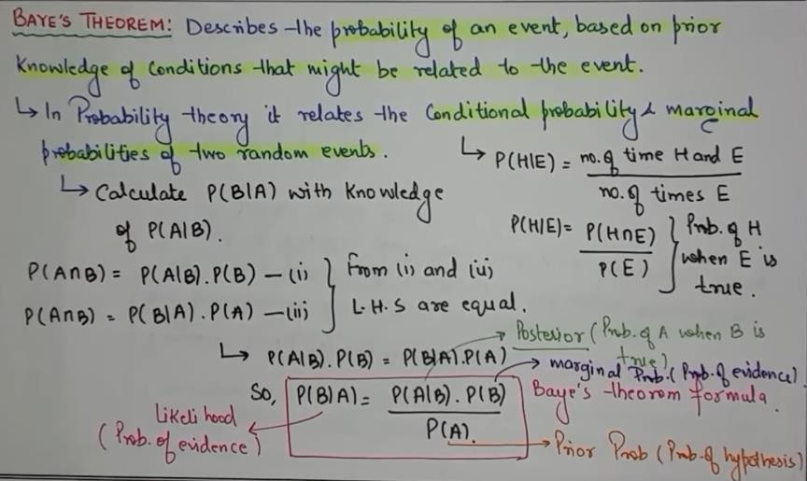
Bayes’ Theorem

Slide 56
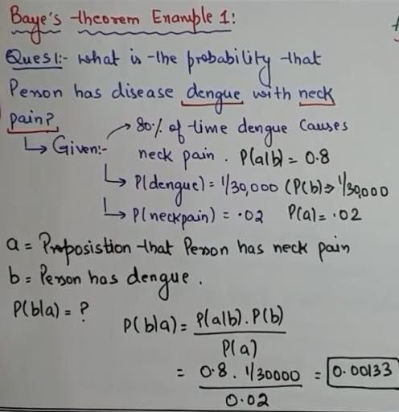
Bayes’ Theorem

Slide 57
Probabilistic Reasoning
As probabilistic reasoning uses probability and related terms, so before understanding probabilistic reasoning, let's understand some common terms:
Probability: Probability can be defined as a chance that an uncertain event will occur. It is the numerical measure of the likelihood that an event will occur. The value of probability always remains between 0 and 1 that represent ideal uncertainties.
0 ≤ P(A) ≤ 1, where P(A) is the probability of an event A.
P(A) = 0, indicates total uncertainty in an event A.
P(A) =1, indicates total certainty in an event A.

Slide 58
Probabilistic Reasoning
We can find the probability of an uncertain event by using the below formula.
P(¬A) = probability of a not happening event.
P(¬A) + P(A) = 1.
Event: Each possible outcome of a variable is called an event.
Sample space: The collection of all possible events is called sample space.
Random variables: Random variables are used to represent the events and objects in the real world.
Prior probability: The prior probability of an event is probability computed before observing new information.
Posterior Probability: The probability that is calculated after all evidence or information has taken into account. It is a combination of prior probability and new information.

Slide 59
Probabilistic Reasoning
Conditional probability:
Conditional probability is a probability of occurring an event when another event has already happened.
Let's suppose, we want to calculate the event A when event B has already occurred, "the probability of A under the conditions of B", it can be written as:
Where
P(A⋀B)= Joint probability of A and B
P(B)= Marginal probability of B.
If the probability of A is given and we need to find the probability of B, then it will be given as:

Slide 60
Probabilistic Reasoning
Example:
In a class, there are 70% of the students who like English and 40% of the students who likes English and mathematics, and then what is the percent of students those who like mathematics?
Solution:
Let, A is an event that a student likes Mathematics
B is an event that a student likes English.
Hence, 57% are the students who like Mathematics.

Slide 61
Bayes' Theorem
Bayes' theorem is also known as Bayes' rule, Bayes' law, or Bayesian reasoning, which determines the probability of an event with uncertain knowledge.
In probability theory, it relates the conditional probability and marginal probabilities of two random events.
Bayes' theorem was named after the British mathematician Thomas Bayes. The Bayesian inference is an application of Bayes' theorem, which is fundamental to Bayesian statistics.
It is a way to calculate the value of P(B|A) with the knowledge of P(A|B).
Bayes' theorem allows updating the probability prediction of an event by observing new information of the real world.

Slide 62



Bayes' Theorem
Example: If cancer corresponds to one's age then by using Bayes' theorem, we can determine the probability of cancer more accurately with the help of age.
Bayes' theorem can be derived using product rule and conditional probability of event A with known event B:
As from product rule we can write:
Similarly, the probability of event B with known event A:
Equating right hand side of both the equations, we will get:
(a)
The above equation (a) is called as Bayes' rule or Bayes' theorem. This equation is basic of most modern AI systems for probabilistic inference.

Slide 63

Bayes' Theorem
It shows the simple relationship between joint and conditional probabilities. Here,
P(A|B) is known as posterior, which we need to calculate, and it will be read as Probability of hypothesis A when we have occurred an evidence B.
P(B|A) is called the likelihood, in which we consider that hypothesis is true, then we calculate the probability of evidence.
P(A) is called the prior probability, probability of hypothesis before considering the evidence
P(B) is called marginal probability, pure probability of an evidence.
In the equation (a), in general, we can write P(B) = P(A)*P(B|Ai), hence the Bayes' rule can be written as:
Where A₁, A₂, A₃,........, A_{n} is a set of mutually exclusive and exhaustive events.

Slide 64

Applying Bayes' rule
Example - 1:
Question: what is the probability that a patient has diseases meningitis with a stiff neck?
Given Data: A doctor is aware that disease meningitis causes a patient to have a stiff neck, and it occurs 80% of the time. He is also aware of some more facts, which are given as follows:
The Known probability that a patient has meningitis disease is 1/30,000.
The Known probability that a patient has a stiff neck is 2%.
Let a be the proposition that patient has stiff neck and b be the proposition that patient has meningitis. , so we can calculate the following as:
P(a|b) = 0.8
P(b) = 1/30000
P(a)= .02
Hence, we can assume that 1 patient out of 750 patients has meningitis disease with a stiff neck.

Slide 65


Applying Bayes' rule
Example-2:
Question: From a standard deck of playing cards, a single card is drawn. The probability that the card is king is 4/52, then calculate posterior probability P(King|Face), which means the drawn face card is a king card.
Solution:
P(king): probability that the card is King= 4/52= 1/13
P(face): probability that a card is a face card= 3/13
P(Face|King): probability of face card when we assume it is a king = 1
Putting all values in equation (i) we will get:

Slide 66
Belief Networks
A belief network (Bayes net) represents the dependence between variables.
Components of a belief network graph:
Nodes
These represent variables
Links
X points to Y if X has a direct influence on Y
Conditional probability tables
Each node has a CPT that quantifies the effects the parents have on the node
The graph has no directed cycles

Slide 67
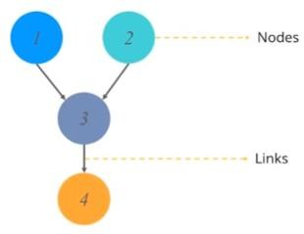
Bayesian Network
Bayesian network falls under the category of probabilistic Graphical Modeling(PGM) technique that is used to compute uncertainties by using the concept of probability.
Bayesian network is known as belief network or casual network
Bayesian network is based on the concept of probability. It can be represented by using a directed acyclic graph.
Directed acyclic graph is used to represent Bayesian network and like any other statistical group. DAG contains a set of nodes and links, where the link denote the relationship between the nodes.

Slide 68
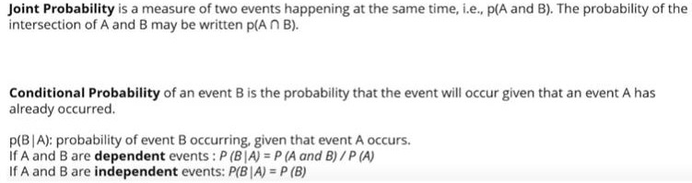
Bayesian Network
DAG models the uncertainty of an event occurring based on conditional probability distribution of each random variable.
Conditional probability table is used to represent this distribution of each variable in the network.

Slide 69
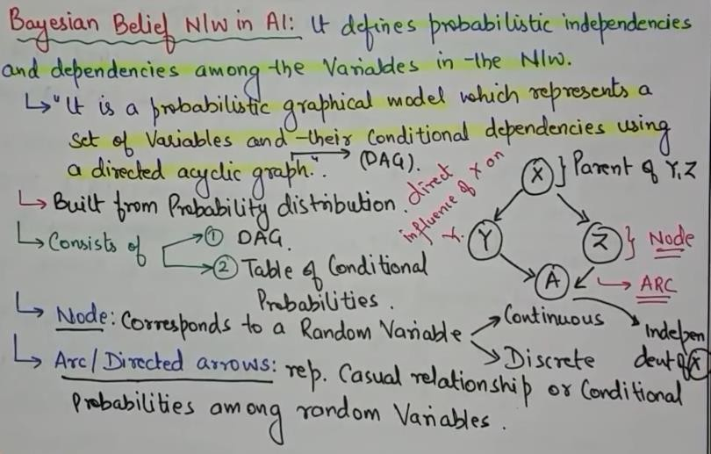
Bayesian Belief Network

Slide 70
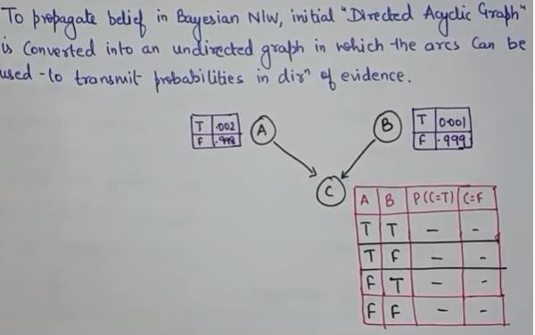
Bayesian Belief Network

Slide 71
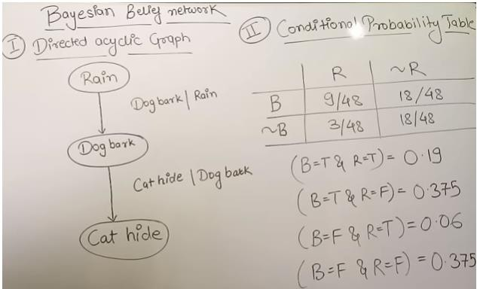
Bayesian Network Example
Convenient events.
for representing probabilistic relation between multiple

Slide 72
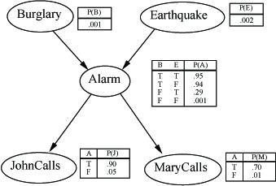
Bayesian Network Example2
I'm at work, neighbor John calls to say my alarm is ringing, but neighbor Mary doesn't call. Sometimes it's set off by minor earthquakes. Is there a burglar?
Variables: Burglar, Earthquake, Alarm, JohnCalls, MaryCalls Network topology reflects “causal” knowledge:

Slide 73
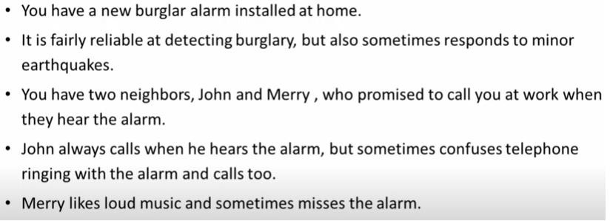
Bayesian Network Example2
Given the evidence of who has or has not called, we would like to estimate the probability of a burglary.

Slide 74
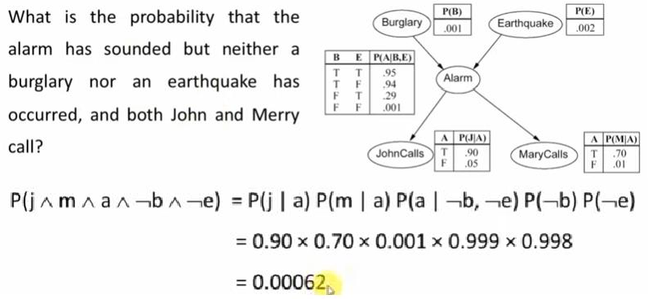
Bayesian Network Example2

Slide 75
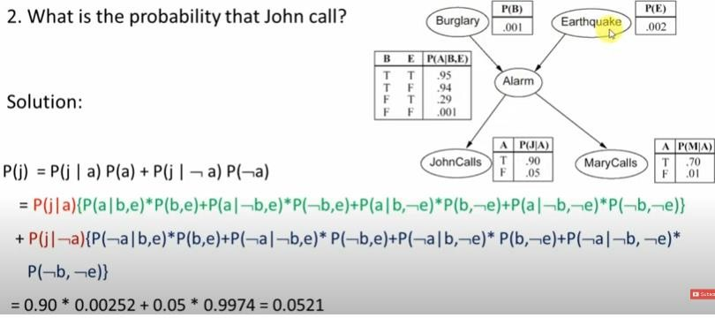
Bayesian Network Example2

Slide 76
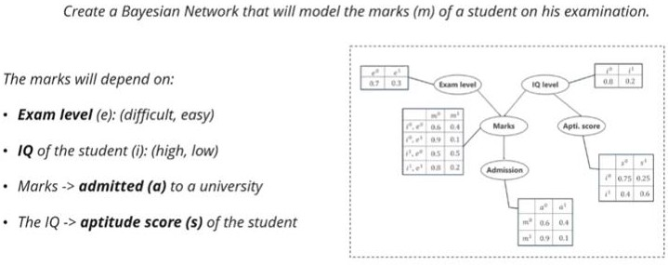
Bayesian Network Example
There should not be a cycle.

Slide 77
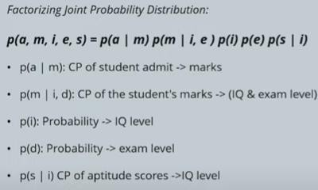
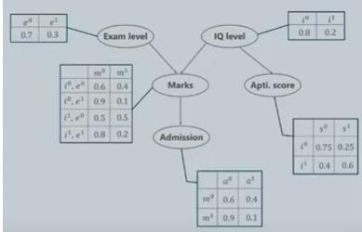
Bayesian Network Example

Slide 78
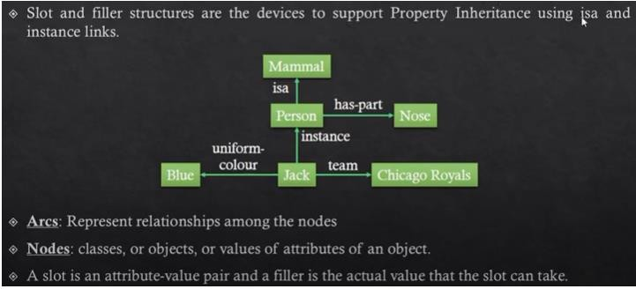
Semantic Nets
Semantic Nets – way of representing knowledge and are based on property inheritance.
How to represent English statements using semantic nets?
Represent knowledge with the help of property inheritance we take the help of structures called slot and filler structures.

Slide 79
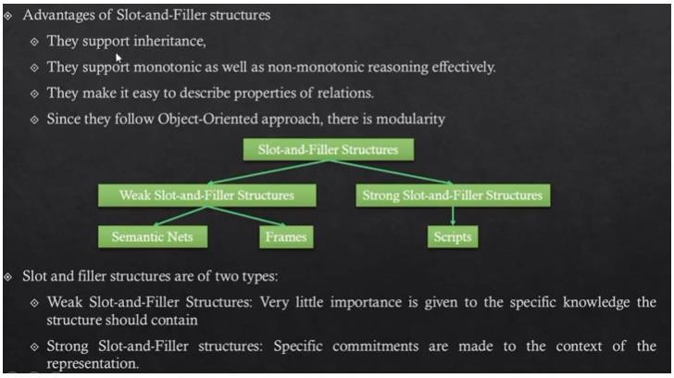
Semantic Nets

Slide 80
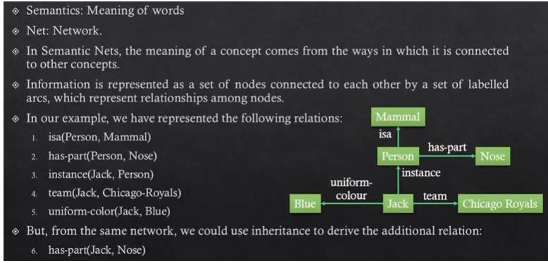
Semantic Nets

Slide 81
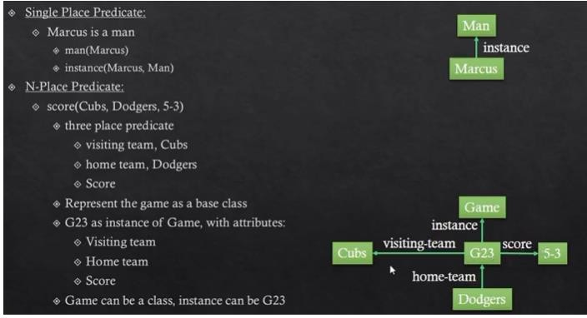
Representing N-place Predicates using Semantic Nets

Slide 82
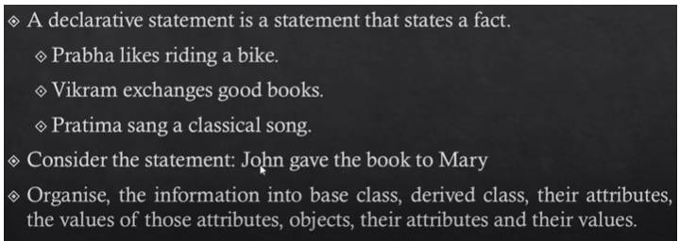
Representing Declarative Statement using Semantic Nets

Slide 83
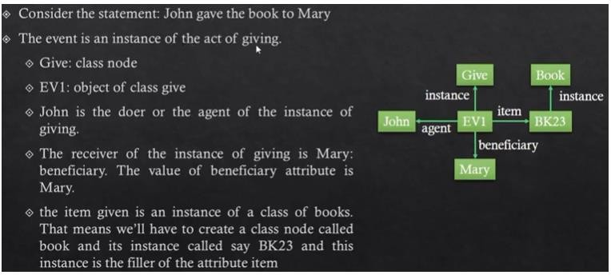
Representing Declarative Statement using Semantic Nets

Slide 84
Frame Representation
When an agent encounters a new situation, it will need to retrieve information to act rationally in that situation. This information is likely to be multi-faceted and hierarchical. One way of structuring the knowledge is in terms of frames. These are frameworks consisting of slots.
Each slot containing information in various representations like logical sentences, production rule, frame etc. Each framework represents a stereotypical object or situation.
Whenever an agent encounters an object or situation which fits the stereotype, agent retrieve the framework and change some default information or fill the blank information. Some of the information is procedural, so that when a blank is filled in with certain values, a procedure must be carried out. In this way frame dictate how to act rationally in situations.
Types of Information store in slot
Information for choosing the frame
Information about relationships between frames.
Procedures to be carried out.
Default information.
Blank slots.

Slide 85
Frame Representation
Information for choosing the frame
It may also be information about situations or descriptors for the stereotype the frame represents. E.g. name ,id
Information about relationships between frames
Two frames should never be considered at the same time whether this frame is a generalisation or specialisation of another frame.
Procedures to be carried out
It is rational action an agent should do in a situation where a particular value for a slot has been identified.
Default information
It’s the values when certain information required for the frame is missing.
Default information is used in choosing actions until more specific information is found.
Blank slots
These are flagged to be left blank unless required for a particular task.

Slide 86
Frames
It means of representing common sense knowledge. Knowledge is organized into small packets called “Frames”. All frames of a given situation constitute the system.
A frame can be defined as a structure that has slots for various objects & a collection of frames consist of expectation for a given situation.
Frame are used to represent two types of knowledge viz. declarative/factual and procedural, declarative & procedural Frames.
A frame that merely contains description about objects is call a declarative type situational frame.
Name : Computer Centre
A/c | Stationary cupboard
Computer | Dumb terminals
Printer
Name of the frame
Slots in the frame

Slide 87
Frames
Frames which have procedural knowledge embedded in it are called action procedure frames. The action frame has the following slots:
Actor slot which holds information @ who is performing the activity.
Source Slot hold information from where the action has to begin.
Destination slot holds information about the place where action has to end.
Task slot, this generates the necessary sub frames required to perform the operation.
Name : Cleaning the ict of carburetor
Actor
Source |  | Expert Object Destination
Scooter |  |  |  | Scooter
Task 1 | Task 3 | Task 2
Remove Carburetor |  |  | Clean Nozzle |  | Fix Carburetor

Slide 88
Fuzzy Logic
Fuzzy Logic looks at the world in imprecise terms, in much the same way that our brain takes in information (e.g. temperature is hot, speed is slow), then responds with precise actions.
Fuzzy Logic is an approach to computing based on "degrees of truth" rather than the usual "true or false" logic. The human brain can reason with uncertainties, vagueness, and judgments. Computers can only manipulate precise valuations. Fuzzy logic is an attempt to combine the two techniques.
Fuzzy logic is in fact, a precise problem-solving methodology. Fuzzy logic differs from classical logic in that statements are no longer black or white, true or false, on or off.
In traditional logic an object takes on a value of either zero or one. In fuzzy logic, a statement can assume any real value between 0 and 1, representing the degree to which an element belongs to a given set. Works with imprecise statements such as: In a process control situation, “If the temperature is moderate and the pressure is high, then turn the knob slightly right”
It represent uncertainty
Represent with degree
Represent the belongingness of a member of a crisp set to fuzzy set.

Slide 89
Fuzzy Logic Applications
For washing machines, Fuzzy Logic control is almost becoming a standard feature: fuzzy controllers to load-weight, fabric-mix, and dirt sensors and automatically set the wash cycle for the best use of power, water, and detergent.
NASA has studied fuzzy control for automated space docking: simulations show that a fuzzy control system can greatly reduce fuel consumption
Canon developed an auto-focusing camera that uses a charge-coupled device (CCD) to measure the clarity of the image in six regions of its field of view and use the information provided to determine if the image is in focus. It also tracks the rate of change of lens movement during focusing, and controls its speed to prevent overshoot.
Nissan – fuzzy automatic transmission, fuzzy anti-skid braking system
CSK, Hitachi – Hand-writing Recognition
Ricoh, Hitachi – Voice recognition
Automotive system for speed control, traffic control.

Slide 90
Fuzzy Logic-Set Theory
The Classical/Crisp set is defined in such a way that the universe of discourse is spitted into two groups members and non-members. Hence, In case classical sets, no partial membership exists.
In a Crisp set, membership or non-membership of element “x” in set A is described by a characteristic function
Fuzzy set is a set having degrees of membership between 1 and 0. Fuzzy sets are represented with tilde character(~). A fuzzy set A on a universe of discourse U is characterized by a membership function that takes values in the interval [0, 1].
Classical set contains elements that satisfy precise properties of membership while fuzzy set contains elements that satisfy imprecise properties of membership.
Fuzzy sets allows partial membership which means that it contain elements that have varying degrees of membership in the set. E.g. {hot, warm, cool, cold}, { not cold, barely cold, bit cold, not quit cold, cold}
A fuzzy set is a mapping of a set of real numbers (x_{i}) onto membership values (u_{i}) that (generally) lie in the range [0, 1]. In this fuzzy package a fuzzy set is represented by a set of pairs u_{i}/x_{i}, where u_{i} is the membership value for the real number x_{i}. We can represent the set of values as { u₁/x₁ u₂/x₂ ... u_{n}/x_{n} }.

Slide 91
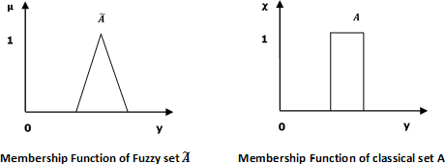
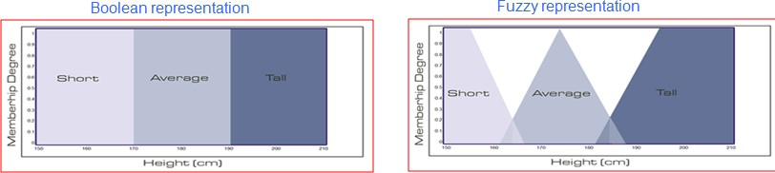
Fuzzy Logic-Set Theory
From this, we can understand the difference between classical set and fuzzy set. Classical set contains elements that satisfy precise properties of membership while fuzzy set contains elements that satisfy imprecise properties of membership.
Example: Is a man whose height is 5‟ 11 average or tall?
A fuzzy system might say that he is partly medium and partly tall.
In fuzzy terms, the height of the man would be classified within a range of [0,1] as average to a degree of 0.6, and tall to a degree of 0.4.

Slide 92

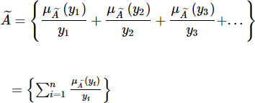
Fuzzy Logic-Set Theory
In other words, FL recognizes not only clear-cut, black-and-white alternatives, but also the infinite gradations in between. Fuzzy reasoning eliminates the vagueness by assigning specific numbers to those gradations. These numeric values are then used to derive exact solutions to problems.
A fuzzy set in the universe of information U can be defined as a set of ordered pairs and it can be represented mathematically as −
Here = degree of membership of y , assumes values in the range from 0 to 1, i.e.,
OR

Slide 93
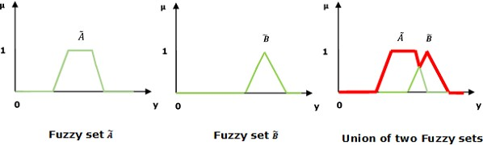
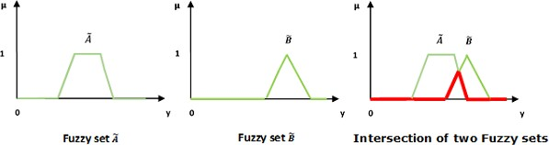
Operations of Fuzzy Set
Union/Fuzzy “OR”
Intersection/Fuzzy "AND‟

Slide 94
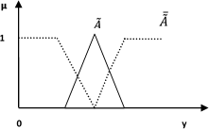
Operations of Fuzzy Set
Complement/Fuzzy "NOT‟

Slide 95
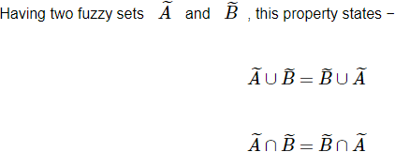
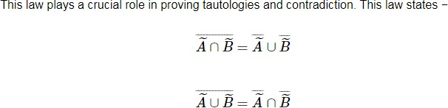




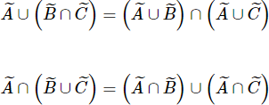
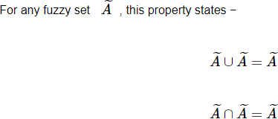
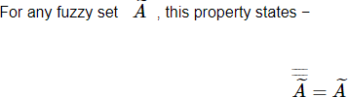
Properties of Fuzzy Set
Commutative Property:
Identity Property:
De Morgan‟s Law:
Distributive Property:
Transitive Property:
Idempotency Property:
Involution Property:

Slide 96
Fuzzy Logic Rule Base
It contains the set of rules and the IF-THEN conditions provided by the experts to govern the decision making system, on the basis of linguistic information.
Recent developments in fuzzy theory offer several effective methods for the design and tuning of fuzzy controllers. Most of these developments reduce the number of fuzzy rules.
Examples:
R1: if temperature is high then Climate is hot
R2: if outlook is sunny and if humidity is high then Decision is No.
R3: if outlook is sunny and if humidity is low then Decision is Yes.
R4: if Tree_distance is SOMEWHAT close AND Tree_angle is small_positive then Turn slightly left

Slide 97
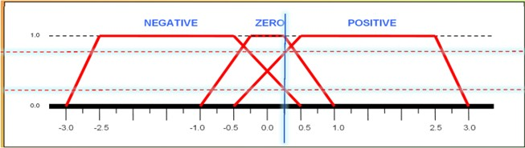
Fuzzification and Defuzzification
Fuzzification:- Input variables are assigned degrees of membership in various classes. The purpose of fuzzification is to map the inputs from a set of sensors (or features of those sensors such as amplitude or spectrum) to values from 0 to 1 using a set of input membership functions.
Example: Fuzzy Sets = { Negative, Zero, Positive }
Assuming that we are using trapezoidal membership functions.
Crisp Input: x = 0.25
Defuzzification:- It is used to convert the fuzzy sets obtained by inference engine into a crisp value. There are several defuzzification methods available and the best suited one is used with a specific expert system to reduce the error.
Different methods of defuzzification are listed below:
Maxima Methods
Centroid Method
Weighted Average Method
Mean-Max Membership
Smallest of Maxima and Largest of Maxima
Center of Maxima

Slide 98
Fuzzy Inference System
A fuzzy inference system (FIS) is a system that uses fuzzy set theory to map inputs (features in the case of fuzzy classification) to outputs (classes in the case of fuzzy classification). This is a method to map an input to an output using fuzzy logic. Based on this mapping process, the system takes decisions and distinguishes patterns.
Characteristics of Fuzzy Inference System
The output from FIS is always a fuzzy set irrespective of its input which can be fuzzy or crisp.
It is necessary to have fuzzy output when it is used as a controller.
A defuzzification unit would be there with FIS to convert fuzzy variables into crisp variables.
Functional Blocks of FIS
Rule Base − It contains fuzzy IF-THEN rules.
Database − It defines the membership functions of fuzzy sets used in fuzzy rules.
Decision-making Unit − It performs operation on rules.
Fuzzification Interface Unit − It converts the crisp quantities into fuzzy quantities.
Defuzzification Interface Unit − It converts the fuzzy quantities into crisp quantities.

Slide 99
Fuzzy Inference System
Fuzzy Logic Rule Base: Fuzzy rule-based systems are rule-based systems, where fuzzy sets and fuzzy logic are used as tools for representing different forms of knowledge about the problem at hand, as well as for modeling the interactions and relationships existing between its variables. E.g.
R1: IF temperature is hot AND humidity is high. THEN fan speed is fast.
The degree of truth assigned to temperature is hot and to humidity is high.
Fuzzification: It is used to convert inputs i.e. crisp numbers into fuzzy sets. Crisp inputs are basically the exact inputs measured by sensors and passed into the control system for processing, such as temperature, pressure, etc.
Inference Engine: It determines the matching degree of the current fuzzy input with respect to each rule and decides which rules are to be fired according to the input field. Next, the fired rules are combined to form the control actions.
Defuzzification: It is the process of producing a quantifiable result in Crisp logic, given fuzzy sets and corresponding membership degrees. It is the process that maps a fuzzy set to a crisp set.

Slide 100
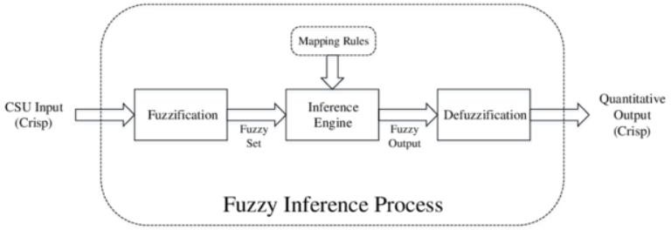
Fuzzy Inference System Architecture
The working of the FIS consists of the following steps −
A fuzzification unit converts the crisp input into fuzzy input.
A knowledge base - collection of rule base and database is formed upon the conversion of crisp input into fuzzy input.
The defuzzification unit fuzzy input is finally converted into crisp output.

Slide 101
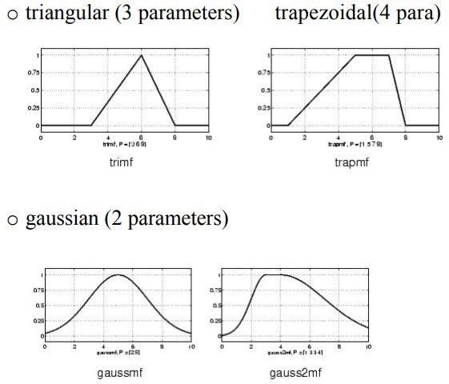
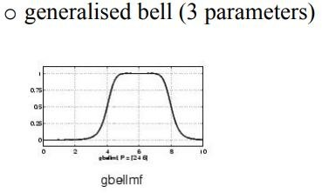
Fuzzy Membership Functions
4 common types of fuzzy membership functions:

Slide 102
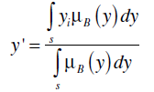
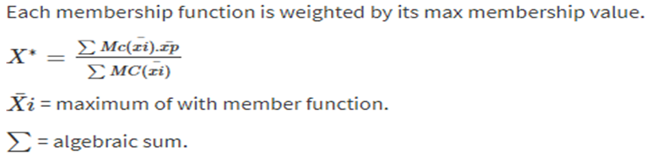

Defuzzification Methods
Max membership principle: In this method, the defuzzifier examines the aggregated fuzzy set and chooses that output y for which is the maximum
Centroid method: centre of mall, centre of gravity or area. In this method, the defuzzifier determines the center of gravity (centroid) of B and uses that value as the output of the FLS. For a continuous aggregated fuzzy set, the centroid is given by
Weighted average method: Valid for symmetrical output membership function.
Mean max membership method: This is known as middle of the maxima.

Slide 103


Defuzzification Methods
Smallest of Maximum and Largest of Maximum
Smallest of max
Largest of max
Center of maxima: In a multimode fuzzy region, the center-of-maxima technique finds the highest plateau and then the next highest plateau. The midpoint between the centers of these plateaus is selected

Slide 104
APPLICATIONS
It is used in the aerospace field for altitude control of spacecraft and satellite.
It has used in the automotive system for speed control, traffic control.
It is used for decision making support systems and personal evaluation in the large company business.
It has application in chemical industry for controlling the pH, drying, chemical distillation process.
Fuzzy logic are used in Natural language processing and various intensive applications in Artificial Intelligence.
Fuzzy logic are extensively used in modern control systems such as expert systems.

Slide 105
Thank you.

